Slide 1
Gender and Women Empowerment in Bangladesh

Slide 2
Basic questions
What is sex?
What is gender?
Are both the same?

Slide 3
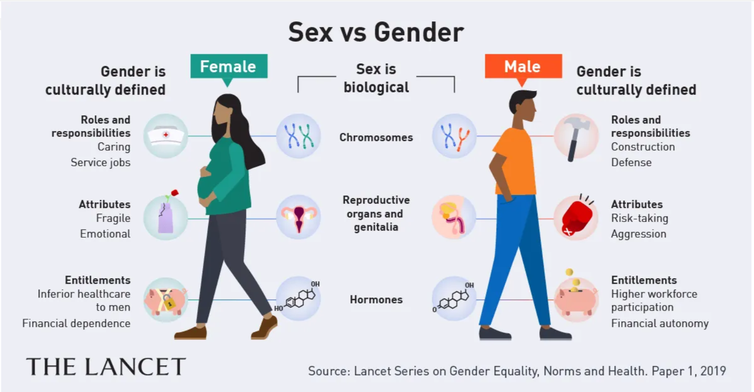

Slide 4

SEX AND GENDER
SEX: Sex is the biological difference between men and women. The sex difference is concerned with men's and women’s bodies.
GENDER: Gender refers to what it means to be a male or a female in our society and culture. Gender is socially constructed and determines the roles, behavior activities, and attributes a particular society considers appropriate for men and women.

Slide 5
Gender
Gender is a social and cultural construct.
The concept of gender includes the expectations held about the roles and behaviors of women and men (femininity and masculinity).
These expectations are learned.
Gender-based roles and other attributes change over time and vary with different cultural contexts.

Slide 6

WOMEN EMPOWERMENT
Women’s Empowerment refers to enabling women to participate equally in economic, social, and political spheres.
It ensures they have the skills, confidence, and opportunities to contribute meaningfully to society.

Slide 7
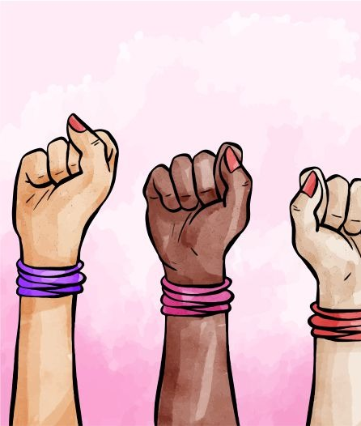
Features of Women Empowerment
Ensure full participation of women in mainstream activities.
Building capacity of women.
Participation in decision-making.
Reduce gender inequality.
Challenge patriarchy and subordination
Strengthen the role of women’s organizations.
Strengthen the institutional capacity for coordination and monitoring of women’s advancement.
Promoting an enabling environment at the workplace.

Slide 8
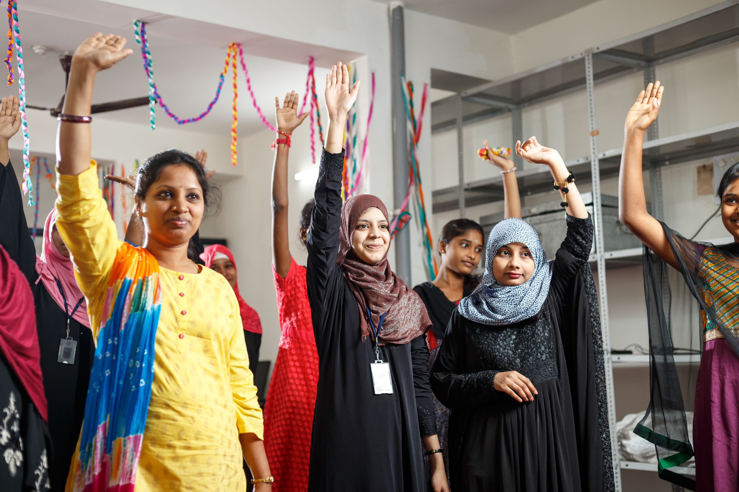
Features of women empowerment
Ensure the social safety of women by protecting them from vulnerability and risks.
Access to quality education and skill development programs.
Economic inclusion and participation in formal employment sectors.
Legal and social rights ensuring safety and equal opportunities.

Slide 9
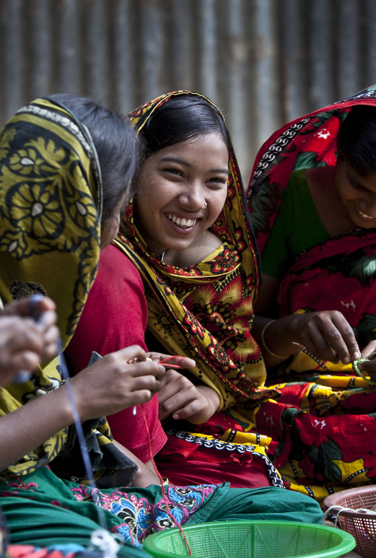
WOMEN EMPOWERMENT IN BANGLADESH
| LEGAL BASIS
Recognizing the importance and contribution of women in society and nation-building, Bangladesh since its independence, has taken legal and policy measures for advancement of women in the country.
The commitment was enshrined in the country’s Constitution. Articles 27, 28, and 29 of the Constitution lay down the general principles regarding the protection of women from all forms of discrimination and promotion of their equal participation.

Slide 10
WOMEN EMPOWERMENT IN BANGLADESH
| LEGAL BASIS
Sustained improvement of relevant legal and policy support coupled with political commitment has seen over the years significant progress in women’s equal participation and empowerment.
According to the Gender Gap Index 2020 by the World Economic Forum, Bangladesh stands 50th out of 153 countries and the 1st in SAARC nations.

Slide 11
WOMEN EMPOWERMENT IN BANGLADESH
| LEGAL BASIS
International framework: Bangladesh has been a signatory to several important international conventions and agreements on women’s and girls’ rights and development. It ratified the Convention on the Elimination of All Forms of Discrimination against Women (CEDAW) in 1984, endorsed the Beijing Platform for Action (BPFA) in 1995, and committed itself to the MDGs in 2000 and SDGs in 2015. Bangladesh also participated in the Commission on Status of Women Meeting every year in New York.

Slide 12
WOMEN EMPOWERMENT IN BANGLADESH
| LEGAL BASIS
Policy and legal framework: The Government has adopted several legal and policy measures to promote and protect the rights of women in the country.
Laws formulated include the Domestic Violence (Prevention and Protection) Act 2010, the Domestic Violence Prevention and Protection Rules 2013, the Prevention and Suppression of Human Trafficking Act 2012, the Hindu Marriage Registration Act 2012, the National Acid Crime Prevention Act (amended) 2010, and the Pornography Control Act 2012, National Children Policy 2011, Child Marriage Restraint Act, 2017, DNA Act, 2014 and Dowry Prohibition Act 2018, etc.
Other laws also gave sufficient attention to women’s rights wherever relevant.

Slide 13
WOMEN EMPOWERMENT IN BANGLADESH
| LEGAL BASIS
National Women Development Policy: A notable action of the Government was the adoption of the National Women Development Policy 2011 and the Action Plan to implement the policy.
To implement this Policy, the Government is committed to helping build the productive capacities of women; providing necessary support to women entrepreneurs; increasing employment opportunities for the skilled and non-skilled female workforce; enhancing the number of women in public and private jobs; operationalizing gender-sensitive planning and budget; ensure equal pay for female workers in all sectors; facilitate enhanced women leadership in the political arena; and increase the number of women at all stages of administration.

Slide 14
WOMEN EMPOWERMENT IN BANGLADESH
| LEGAL BASIS
Gender-responsive budget: In order to ensure the participation of women in all spheres of life, the present government has started gender-responsive budgeting since 2009. At present, all ministries/divisions have adopted various innovative programs to consolidate women’s economic and social empowerment through the implementation of a gender-responsive budget.

Slide 15
WOMEN EMPOWERMENT IN BANGLADESH
| LEGAL BASIS
8th five-year plan of Bangladesh 2020-2025
The gender vision of the 8FYP is that of establishing “a country where men and women will have equal opportunities and rights and women will be recognized as equal contributors in economic, social and political development”.
The mission is to ensure women’s advancement as self-reliant human beings and reduce discriminatory barriers by taking both developmental and institutional measures.

Slide 16
WOMEN EMPOWERMENT IN BANGLADESH
| GOV’T INITIATIVES
Government Manifesto: Carry on initiatives by women’s empowerment by ensuring women’s participation in all ranges of work to eliminate discrimination against women.
Creation of Job Environment for Women: To promote women’s employment efforts are being made to improve the working environment of readymade garments and other offices, creating daycare facilities for the children of the working women. Eight working hostels have been established for the social security of the working women. A total of 119-day care centers have been established for the economic empowerment of working women since 2009.
Income Generating Activities: Under the Income Generation Activities project of the department of Women Affairs, a total of 2 lakh 17 thousand 4 hundred 40 poor, underprivileged women will receive livelihood training and be involved in the existing microcredit program. These women will also have the opportunity to market their own products.

Slide 17
WOMEN EMPOWERMENT IN BANGLADESH
| GOV’T INITIATIVES
Online Self-Reliant E-Training Programme: Government is providing online self-reliant training on different trade to the women. The major objective of the program is to mainstream women into the economic activities of the country. It will increase women skills and also grant market access to them.
Social Safety Net Programmes (SSNPs): The government has allocated Tk 95,574 crore in the social safety net programmes, which is 16.83 percent of total budget and 3.01 percent of GDP in FY 2020-21. The number of recipients of allowances for widows and victims of domestic violence to be increased from 14 lakh to 17 lakh. The number of beneficiaries of maternity allowances for poor mothers to be increased from 7 lakh to 7 lakh 70 thousand. The number of beneficiaries under lactating assistance programmes to be increased from 2 lakh 50 thousand to 2 lakh 75 thousand.

Slide 18
WOMEN EMPOWERMENT IN BANGLADESH
| GOV’T INITIATIVES
Cash Transfer: The government has designed, developed, and successfully piloted an MIS Integrated Government to Person (G2P) Payment System for the transfer of allowances to beneficiaries.
The new system provides:
Timely and regular hassle-free delivery of allowances at the doorsteps of beneficiaries at zero cost to them;
Provides choice for beneficiaries to select according to their convenience the mode of receiving the allowances – Bank, Mobile Financial Services, Post offices, etc.;
Improved Cash Flow Management for the Government. So, these beneficiaries will get their allowances on a particular date sitting at their home.

Slide 19
WOMEN EMPOWERMENT IN BANGLADESH
| GOV’T INITIATIVES
Development of Women Entrepreneurship: Joyeeta was started to promote products and services of women entrepreneurs across the country with a vision of gradually establishing women-friendly infrastructure and spreading them beyond Bangladesh in the long run.
For the continuation of this support a nonprofitable and autonomous foundation has been set up under the Ministry of Women and Children Affairs named Joyeeta Foundation.
The Vision of this foundation is to expedite the process of economic empowerment of women in society.
Selected registered women associations from remote areas of the country are allotted stalls at Rapa Plaza shopping center at Dhanmondi, Dhaka for marketing their products.
For women entrepreneurs’ development, the Joyeeta-Haluaghat Programme has been undertaken as an extension of Joyeeta Programme. After the renovation of Joyeeta-Haluaghat Marketing Centres for women Entrepreneurs, a total of 37 stalls have been opened. In the Marketing Centres, a 3 storied building has been established having with the facility of modern training rooms, child corners, clubs and necessary toilets including more 19 shops.

Slide 20
WOMEN EMPOWERMENT IN BANGLADESH
| GOV’T INITIATIVES
Women’s Access to Resources and Opportunities: Bangladesh Bank is providing collateral-free loans up to Tk. 25 lakh to women entrepreneurs.
In addition, the Small and medium enterprise (SME) Foundation offers a special financial package for women entrepreneurs.
Small women entrepreneurs are also getting financial support from volunteer women’s associations.
Source: https://www.unwomen.org/sites/default/files/Headquarters/Attachments/Sections/CSW/65/MS%20Inputs%20Review%20Theme/Bangladesh.pdf

Slide 21
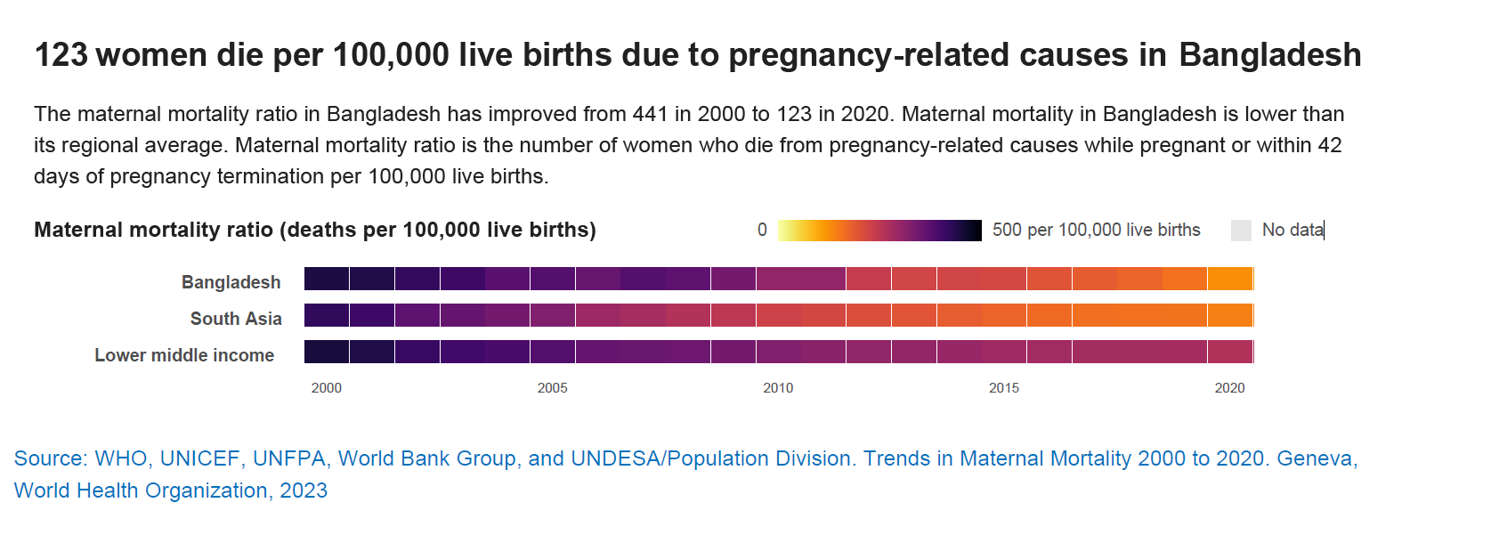
Some statistics about women in Bangladesh

Slide 22
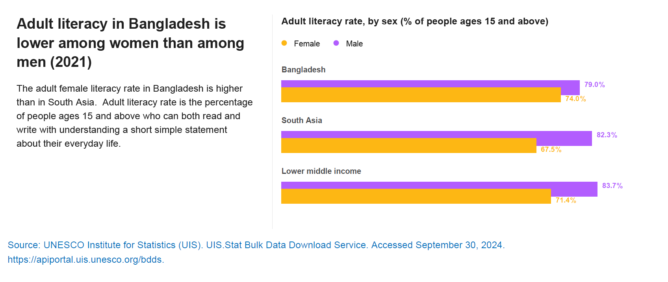
Some statistics about women in Bangladesh

Slide 23
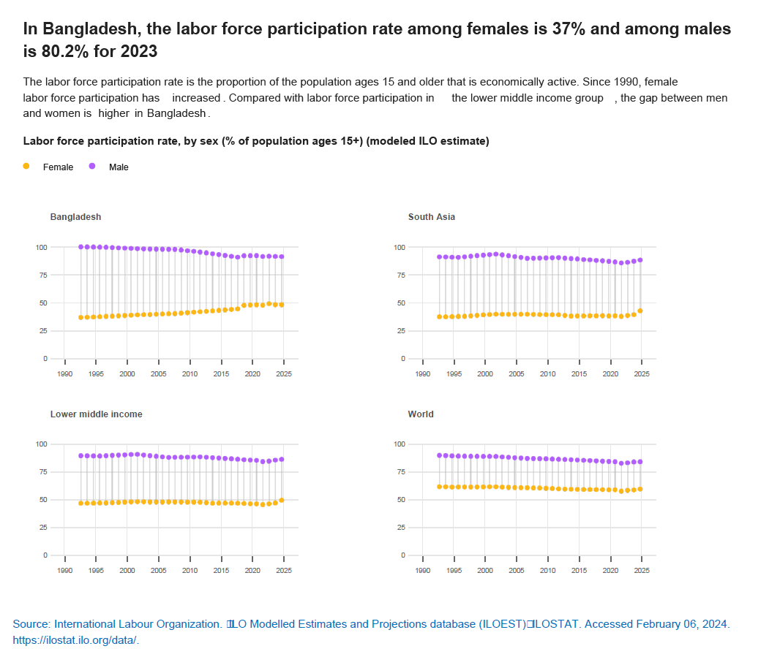
Some statistics about women in Bangladesh

Slide 24
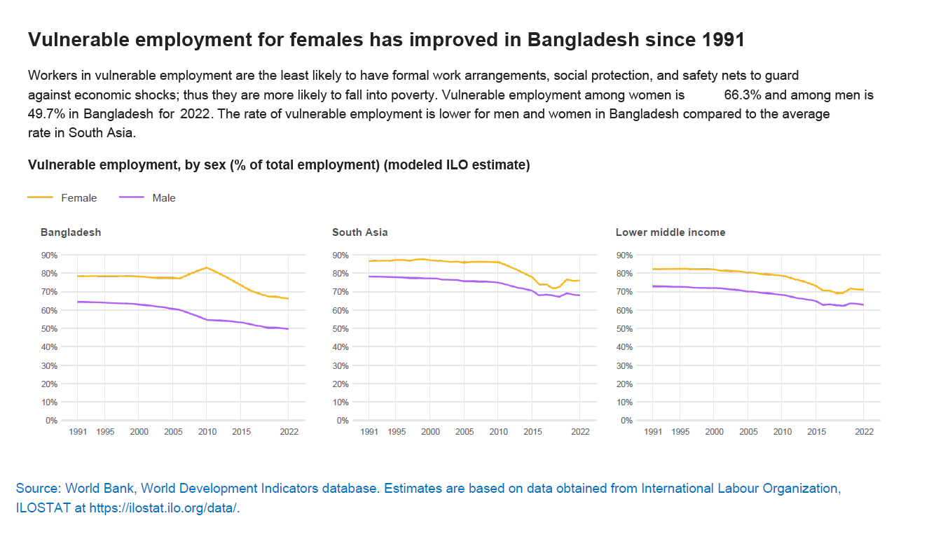
Some statistics about women in Bangladesh

Slide 25
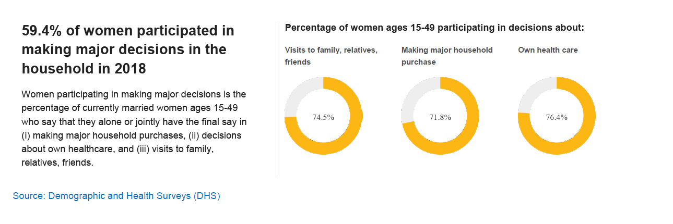
Some statistics about women in Bangladesh

Slide 26
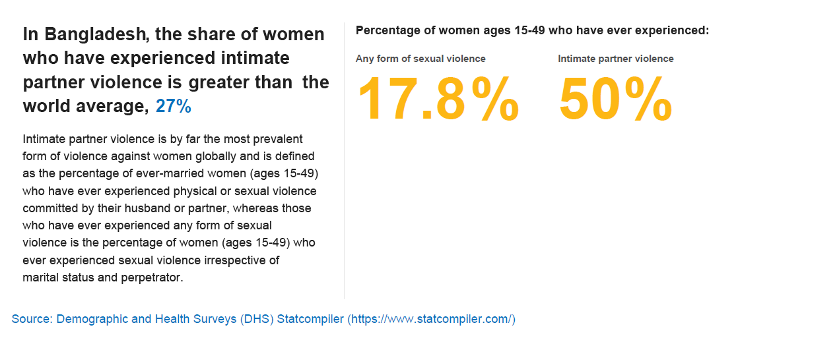
Some statistics about women in Bangladesh

Slide 27
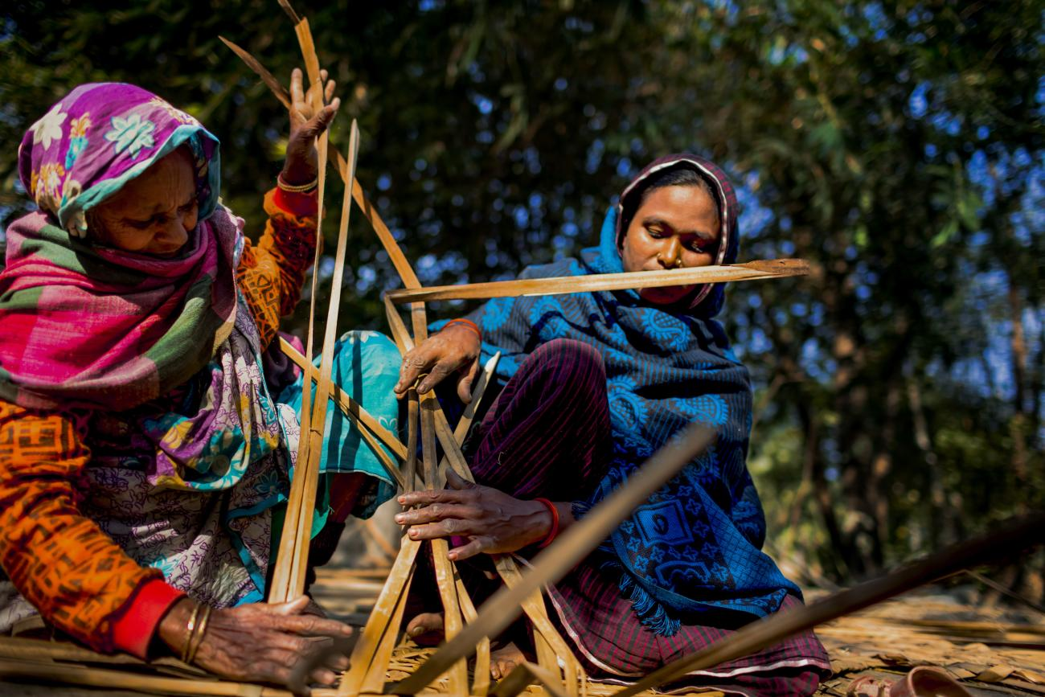
BARRIERS TO WOMEN EMPOWERMENT IN BANGLADESH
SOCIAL BARRIERS
Less education
Ill health facilities
Less access to and control over resources
Violence against women
Patriarchal attitudes
Socialization process
Gender discrimination
POLITICAL BARRIERS
Political instability
Gender insensitivity of political leaders
Male-dominated politics
Political corruption
Lack of political commitment
Under-representation of political decision-making

Slide 28
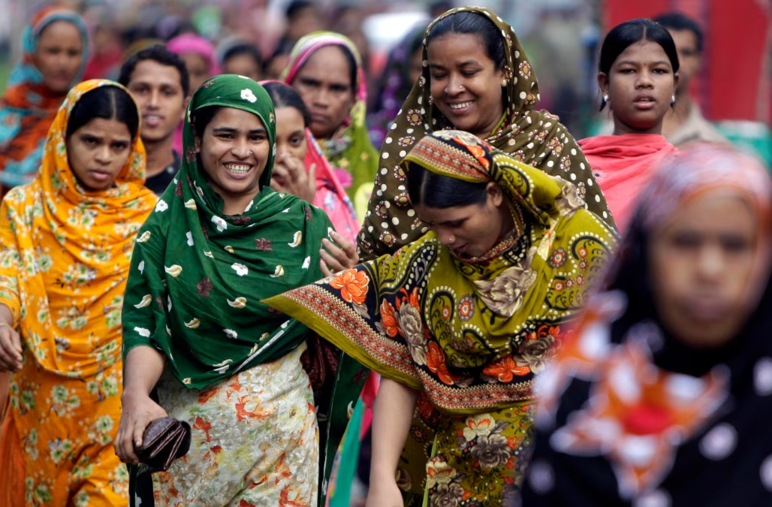
BARRIERS TO WOMEN EMPOWERMENT IN BANGLADESH
CULTURE BARRIERS
Negative societal attitudes
Traditional practices
Negative values
Rigidity in culture
RELIGIOUS BARRIERS
Misinterpretation of religion
Superstition
Fundamentalism
STRUCTURAL BARRIERS
Lack of policy implementation
Lack of implementation of legislative measures
Poorly equipped sector-specific structural like education, health, etc.
Lack of gender-segregated data
Overlook some categories like migrant workers, ethnic people IDPs, third gender, Dalit, etc.
Needs-based program

Slide 29
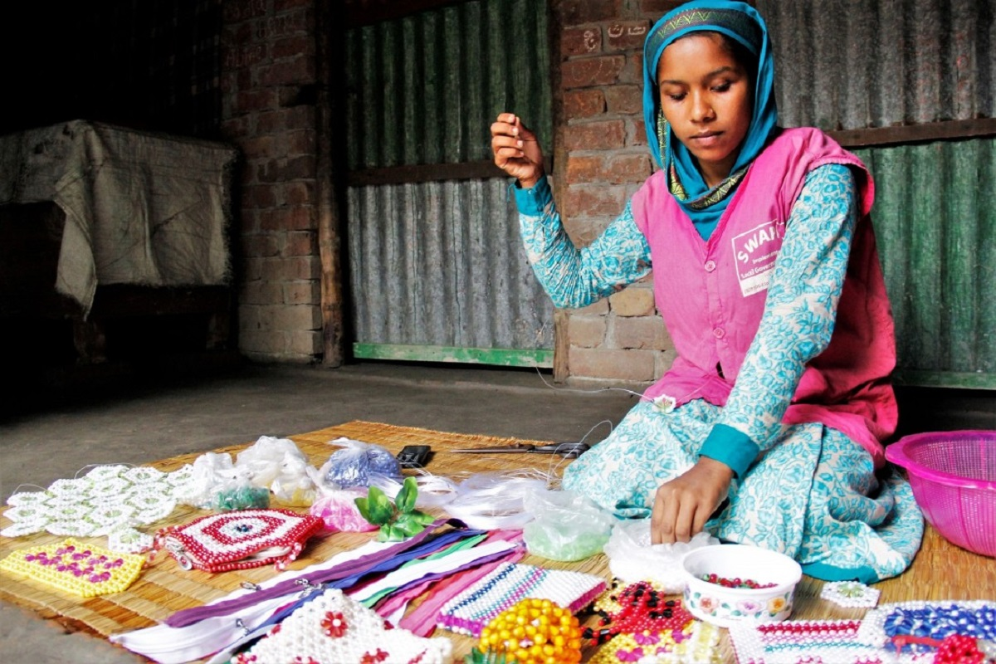
RECOMMENDATIONS FOR WOMEN EMPOWERMENT IN BANGLADESH
Strengthen
Strengthen legal protections by enforcing existing laws on gender-based violence, workplace safety, and equal pay while improving the judicial response to gender discrimination cases.
Enhance
Enhance educational opportunities by implementing specialized programs for women in STEM, digital literacy, and vocational training to prepare them for the modern job market.
Increase
Increase economic access by providing women with greater access to credit, investment opportunities, and entrepreneurship training.
Encourage
Encourage political participation by implementing leadership training programs for women and promoting their representation in policymaking bodies.
Engage
Engage men in gender equality initiatives by conducting awareness programs to change societal attitudes and encourage male allies to support women’s empowerment.

